Slide 1

KRUMBS
An Online food ordering system helping recycle pagbag food
Abhishek Bagdare(001562327)
Deepali Kasture(001586375)
Jharna Doda(002117574)
Viraj Shah(001588964)

Slide 2

Tech Stack Used
Database : MongoDB Atlas, DBAAS
DB Modelling and Conn : Mongoose
Back end web application framework : Express (using Javascript)
Style Sheets : SASS
Front End : React
Design and prototyping Icons : Figma
Licence-free vectors from Flaticon

Slide 3
Overview
Krumbs is an online food ordering platform where customers can browse the menu of multiple restaurants and place the order
It is centric towards leftover food from different restaurants
It’s a one stop place where Customers can order food from multiple restaurants and the admins of the restaurants can CRUD menu operations

Slide 4
User Roles
System Admin
Restaurant Admin
Customer

Slide 5
Features
System Admin
Adds new restaurants that can be hosted on the site
Adds new users (admin) for the restaurant
Revokes restaurant and user access
Restaurant Admin
Manges Menu (CRUD)
Manages Leftover Menu (CRUD)
Manages Orders
Customer
Browse Restaurants
Browse Menu for each resaurant
Add items to cart
Proceed to checkout and place order

Slide 6
API Used/Created
Used REST APIs to connect with MongoDB Atlas, a cloud hosted DBAAS,
REST APIs hosted locally.
CRUD APIs for Restaurant
CRUD APIs for Users
CRUD APIs for elements inside restaurants : Menu items, orders, leftover food items

Slide 7
Contributions
Abhishek : Designed the Architecture of the App, conditional user Flow and developed REST APIs for Menu Items, Order Items, Leftover Food Items, designed Card,Button,table and cart React components, stitched APIs to the react App.
Deepali : Developed REST APIs for Restaurants, Users and designed React components for Menu Items and Leftover Items, stitched APIs to the react App
Jharna :Designed React components, Designed Mongoose Models , Landing Page ,System Admin UI and stitched APIs for them.
Viraj : Designed React components, Designed Mongoose Models , User Dashboard UI and stitched APIs for them.

Slide 8
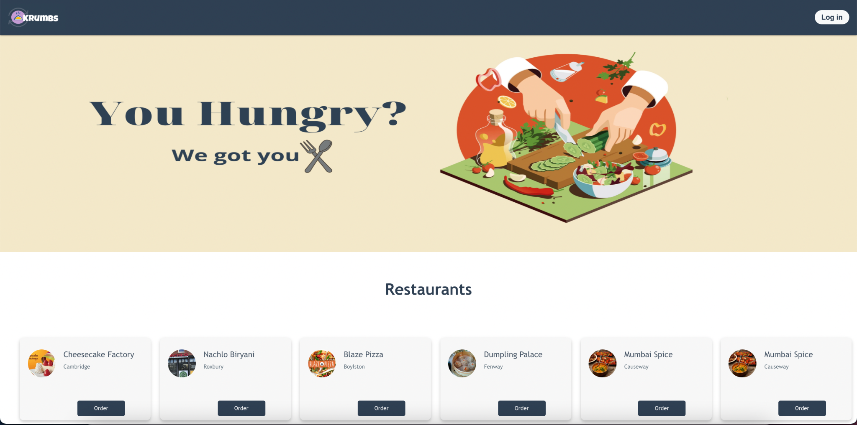
Screenshots
Landing Page

Slide 9
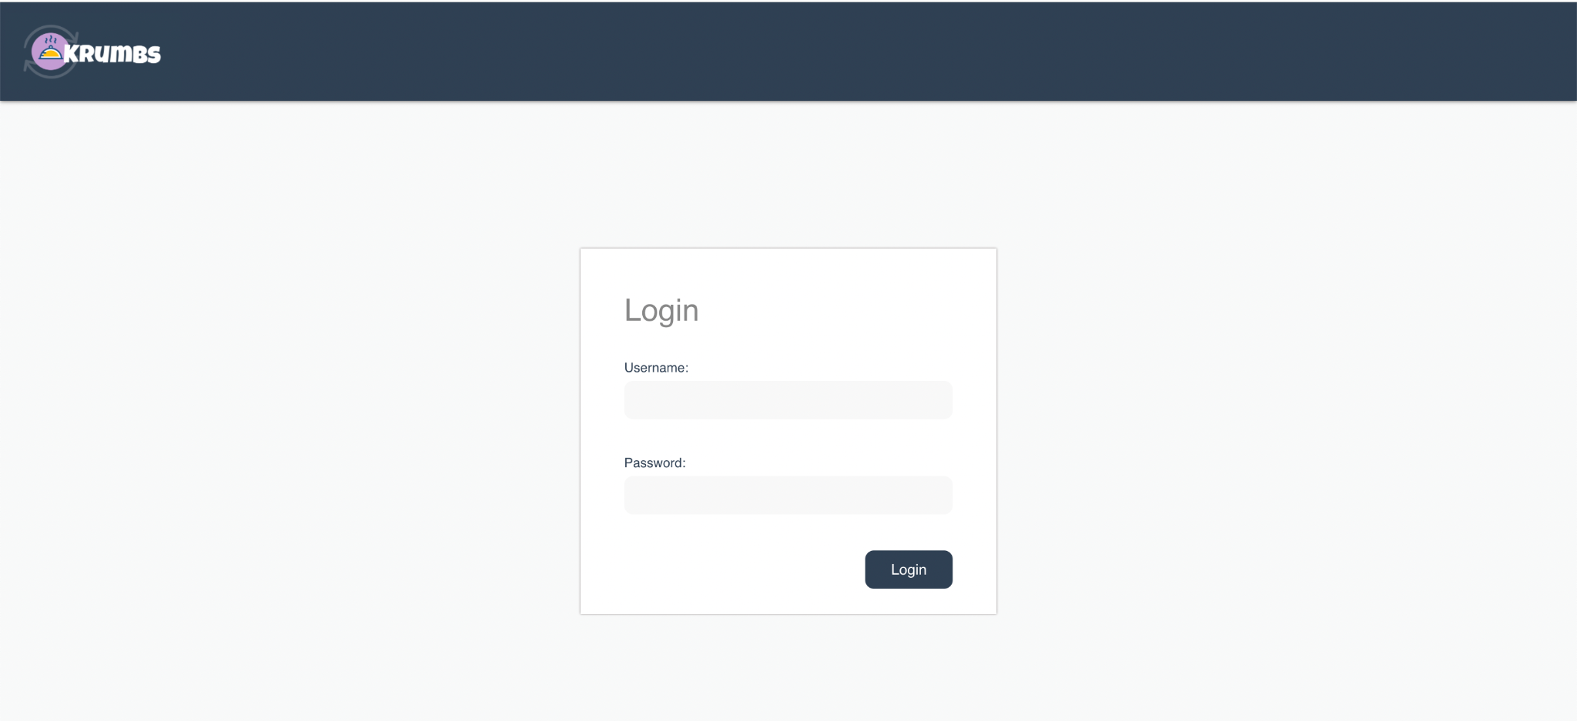
Login Page

Slide 10
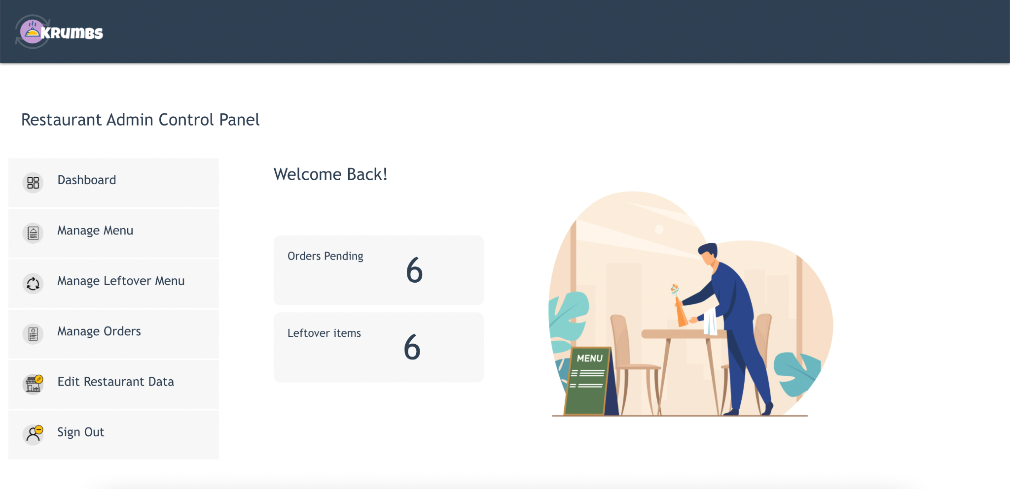
Restaurant Admin Control Panel

Slide 11
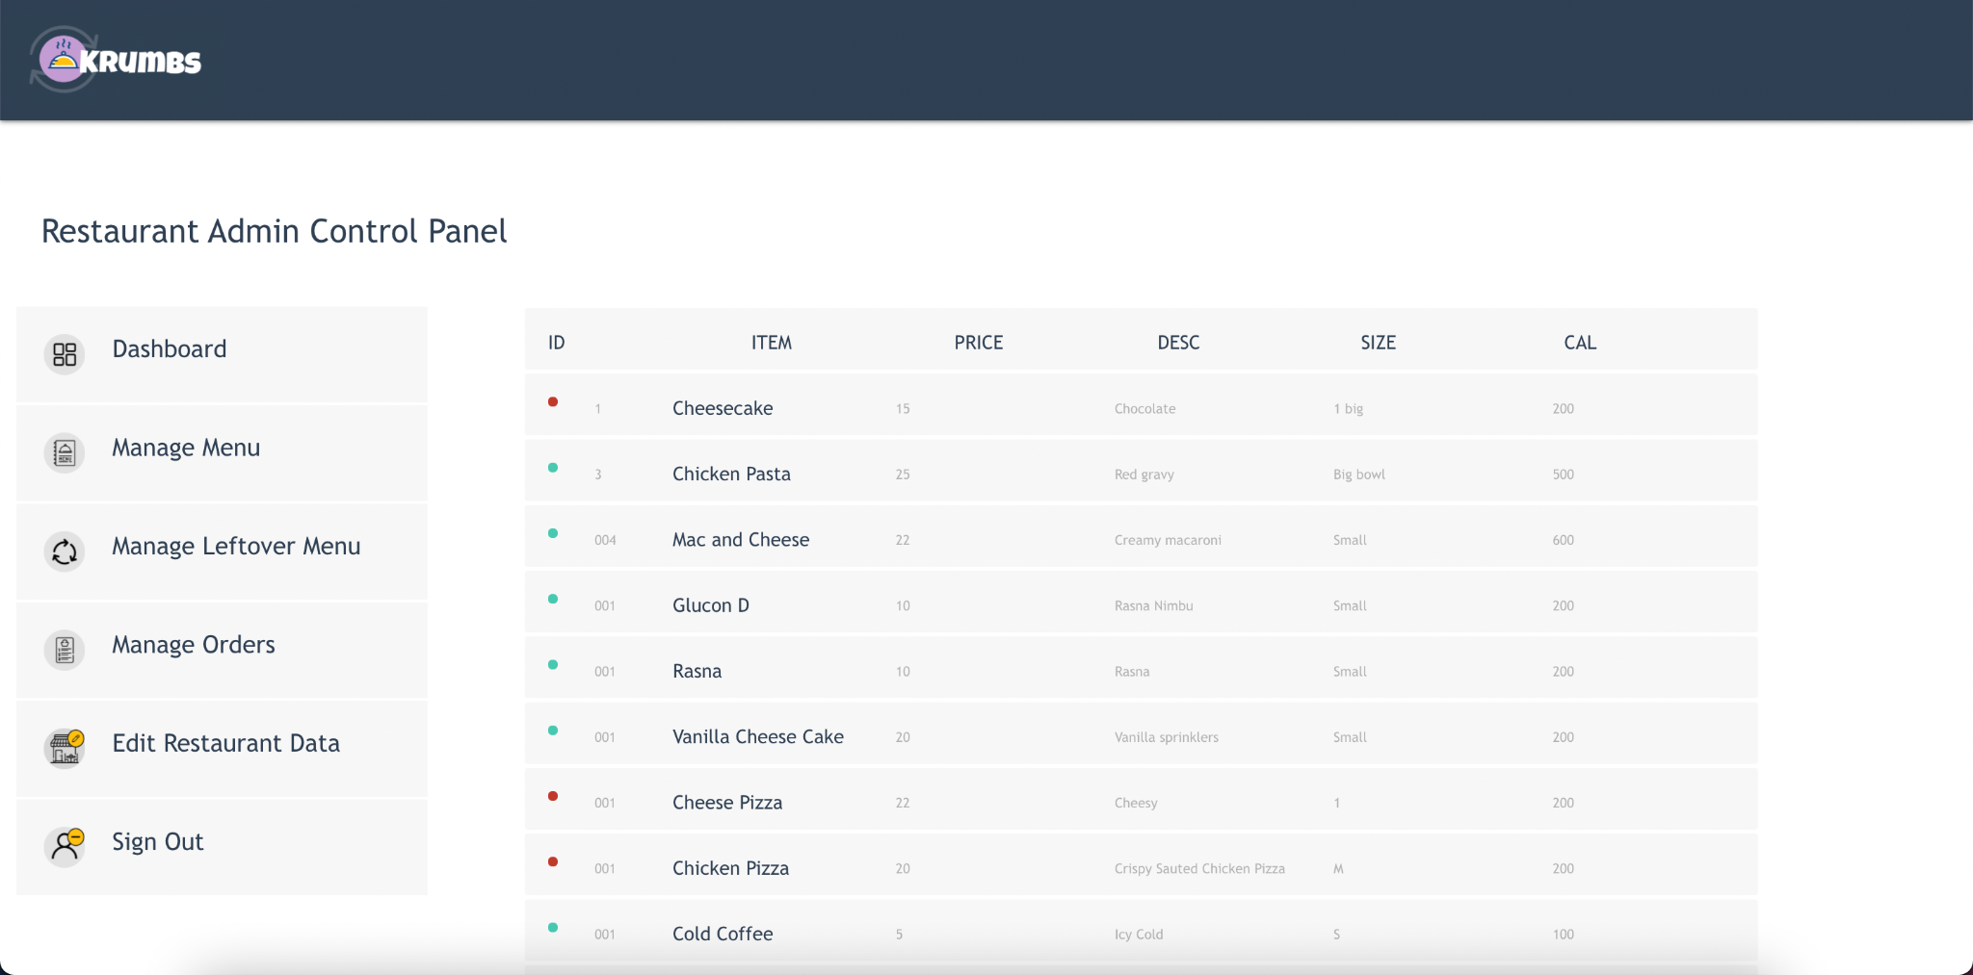
Manage Menu

Slide 12
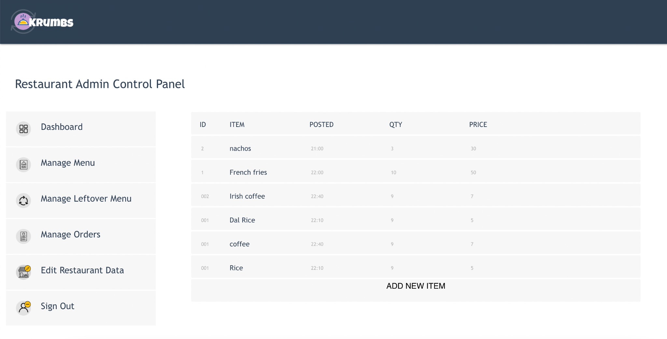
Manage Leftover Menu

Slide 13
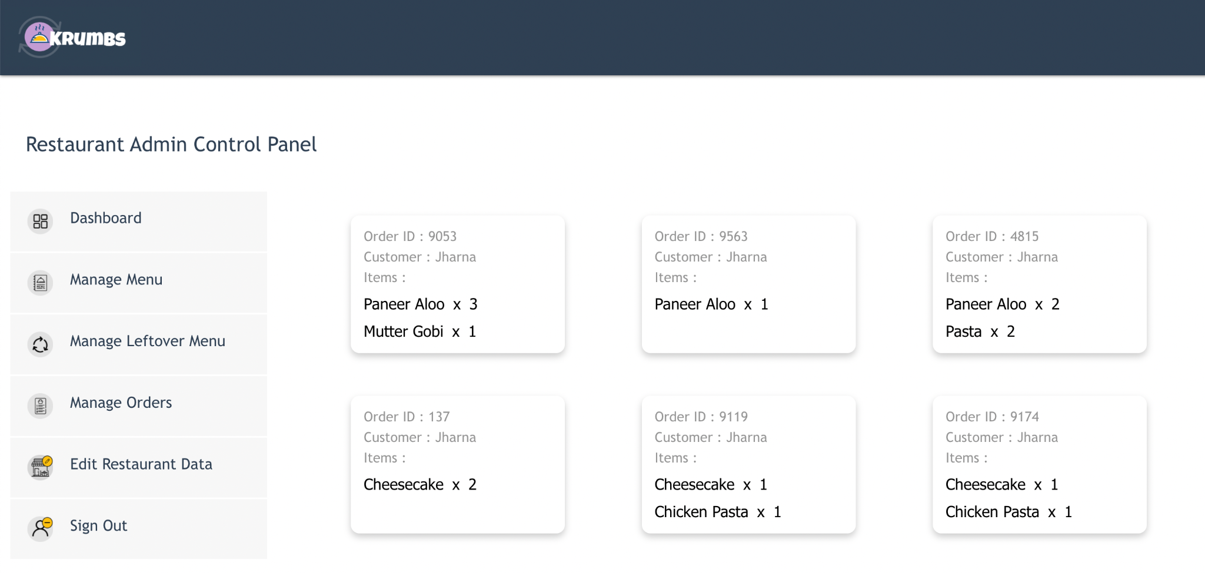
Manage Orders

Slide 14
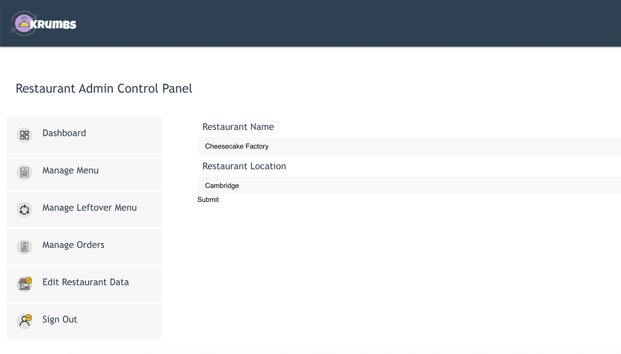
Edit Restaurant Data

Slide 15
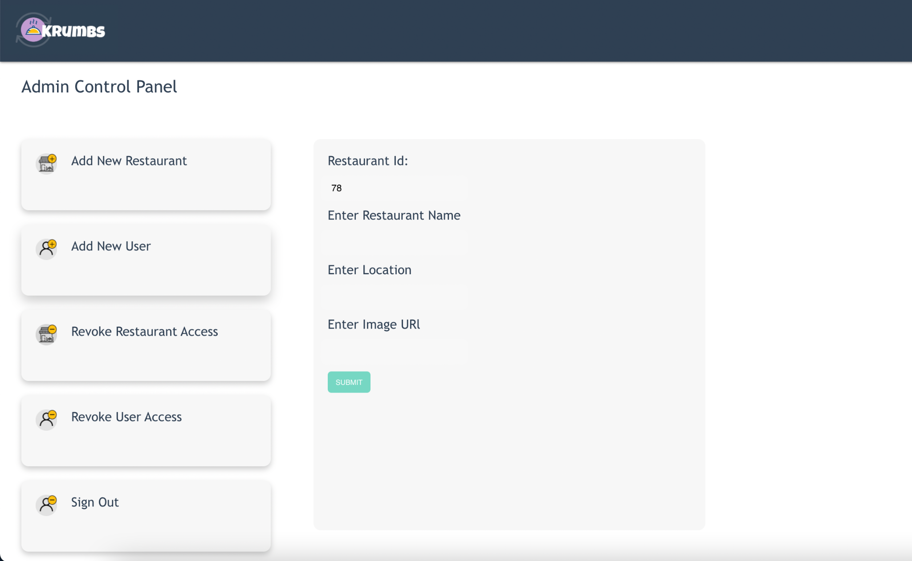
Admin Control Panel

Slide 16
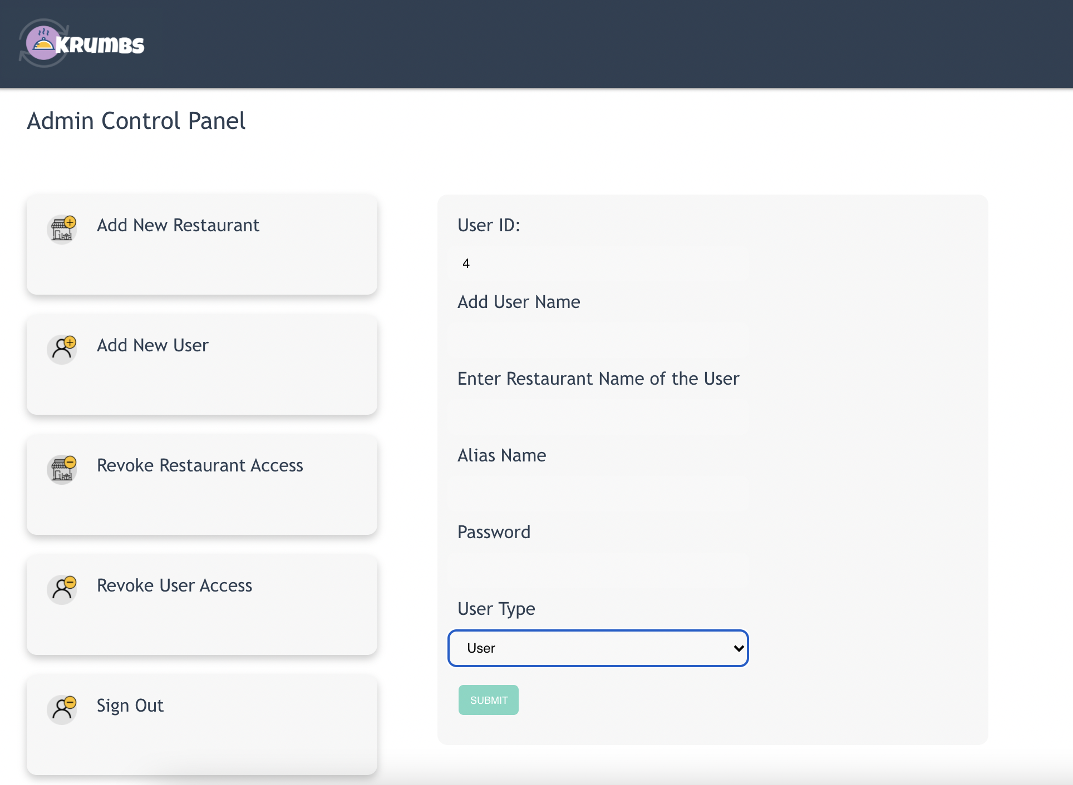
Add New User

Slide 17
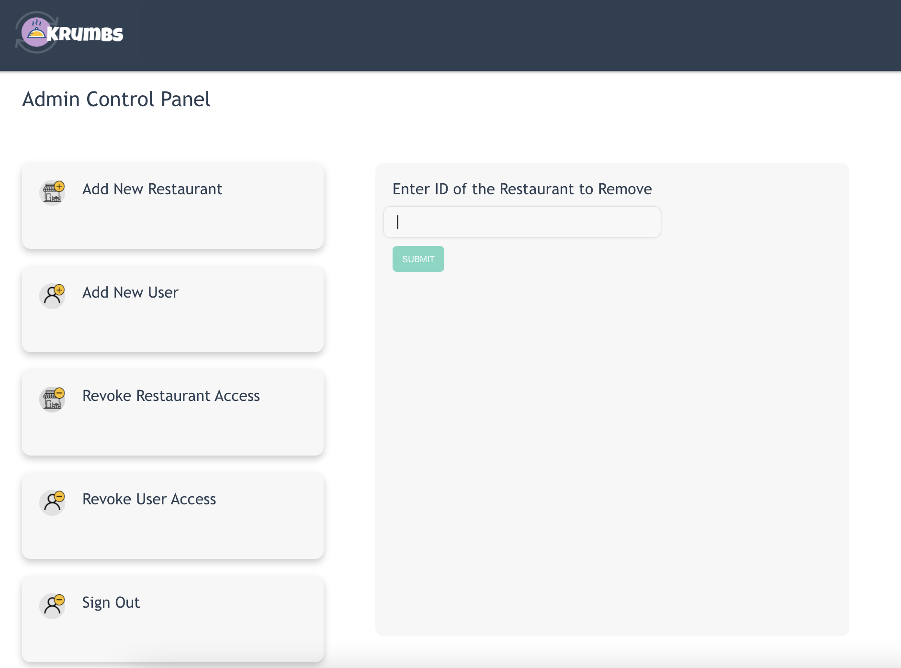
Revoke Restaurant Access

Slide 18
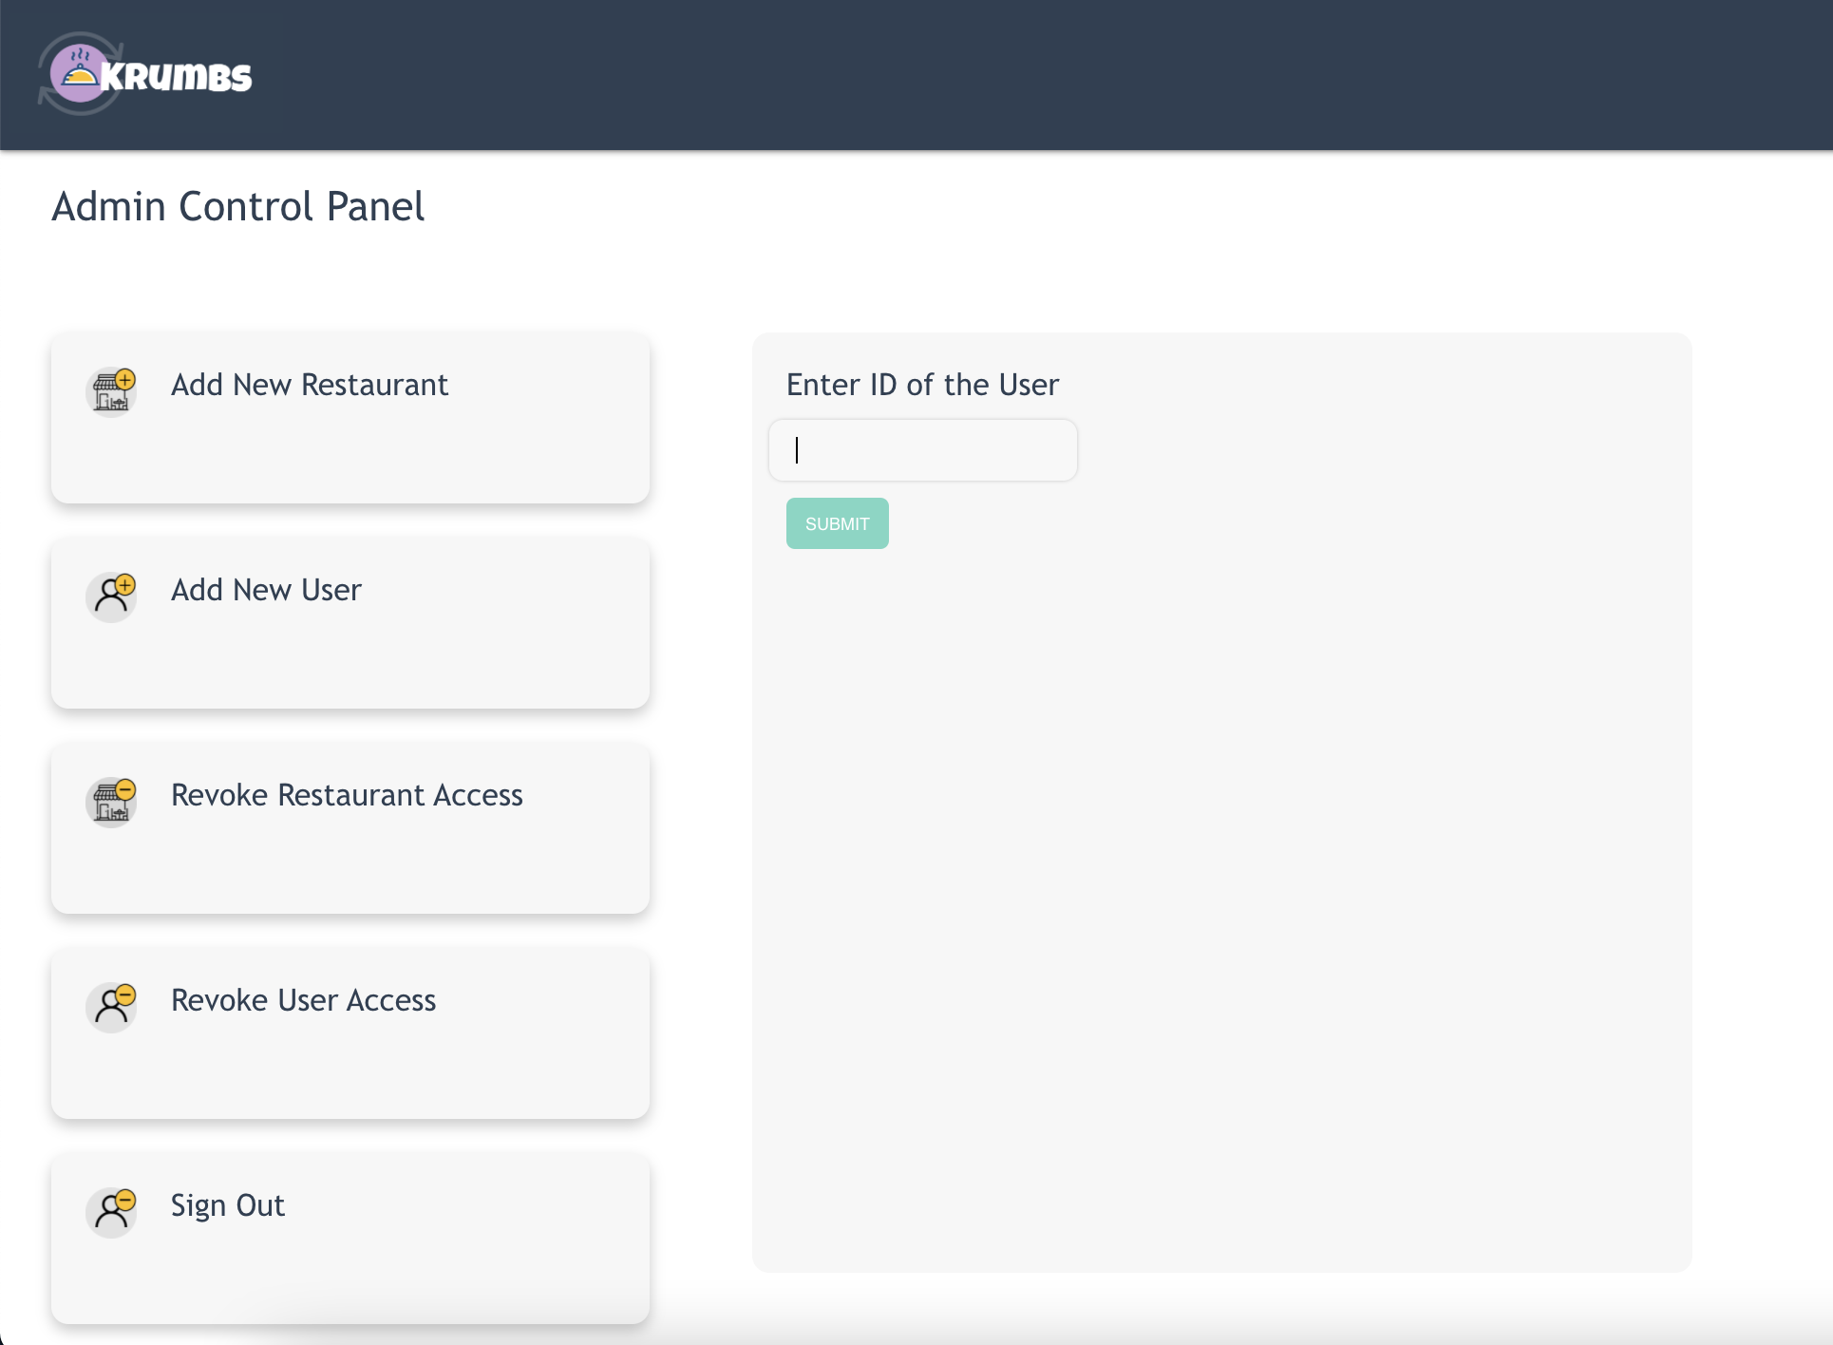
Revoke User Access

Slide 19
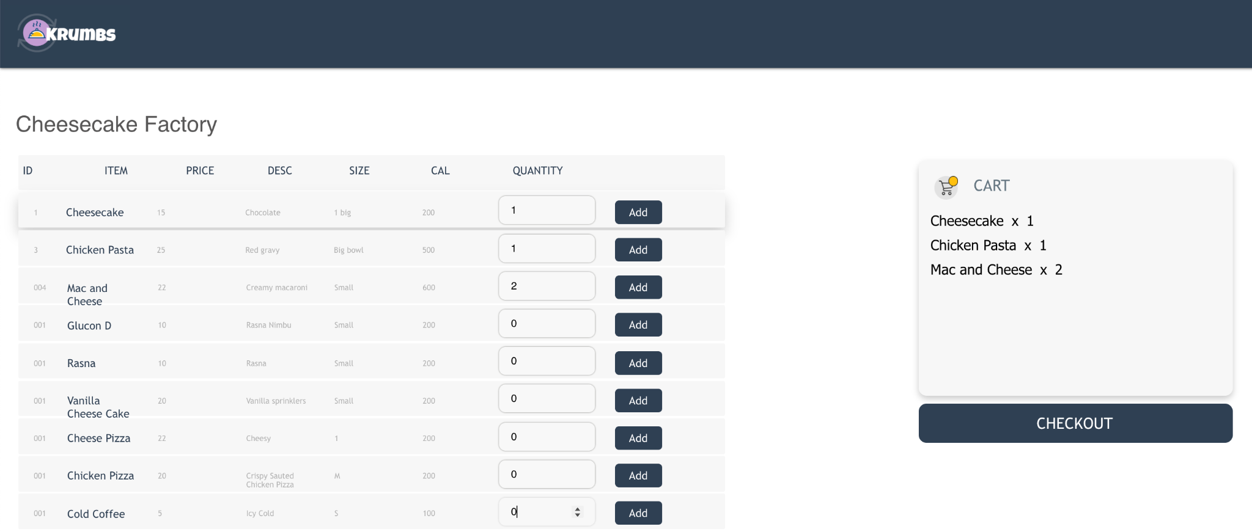
Order

Slide 20
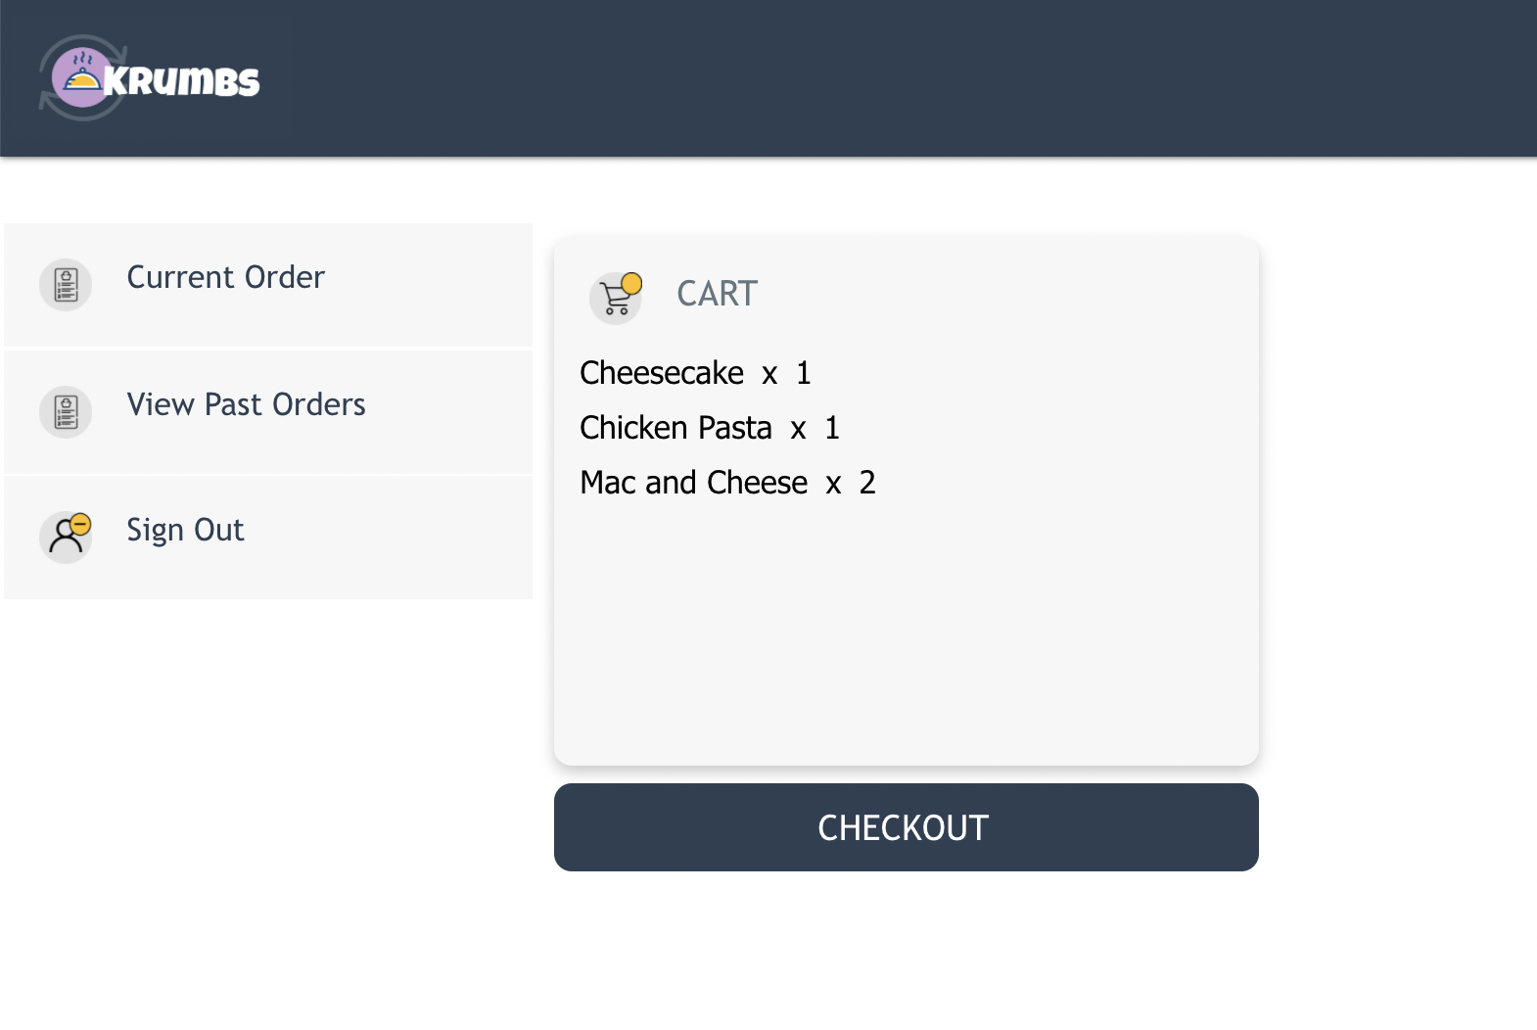
Order History

Slide 21
References
https://reactjs.org/docs/hooks-effect.html
https://mongoosejs.com/docs/api.html
https://docs.mongodb.com/launch-manage/?_ga=2.219423513.1409128633.1638982104-384234323.1634661626&_gac=1.226532975.1638982129.Cj0KCQiAzMGNBhCyARIsANpUkzMqBBJ0Nq4g4DwbAhzPDzuaOEDgAzzURX8n1hz7F40xWY7cQQElKuMaAo_gEALw_wcB
https://expressjs.com/en/starter/generator.html
https://pretagteam.com/question/passing-function-as-a-param-in-reactnavigation-5

Slide 22
Thank you!

